Slide 1
Scenarios for cloud-native applications in IBM Cloud Private

Slide 2
Cloud-native overview

Slide 3
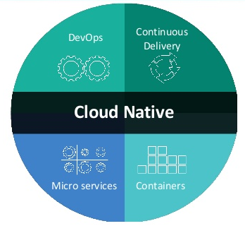
Cloud-native application
According to CNCF, a cloud-native system has the following properties:
Container packaged
Dynamically managed (scheduling)
Microservices oriented
A cloud-native solution is considered to be an application that is compliant with the Twelve-Factor rules
© Copyright IBM Corporation 2017
Notes:
Cloud-native is about structuring teams, culture and technology to utilize automation and architectures to manage complexity. Cloud-native architectures do have certain characteristics which include:
Microservices for repeatable and scalable applications
Container technologies for flexible and portable applications
DevOps for continuous and automated delivery

Slide 4
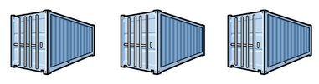
Containers
A container:
Has the benefits of resource isolation and allocation
Runs in a host environment and shares the services that are provided by the host
Helps you build applications faster because you begin with software installed and configured
Containers are portable since any platform with a container engine can run containers.
Containers are easy to manage:
Container images are easy to share, download, and delete (especially with Docker registries)
Container instances are easy to create and delete
Each container instance is easy and fast to start and stop
Containers provide just enough isolation:
More lightweight than virtual machines
Processes share the operating system kernel but are segregated
Containers use hardware more efficiently because of their greater density than virtual machines (especially Docker containers, which can share layers).
Notes:
One principle of cloud-native applications is that they utilized containers for deploying applications. Containers usually contain the application, its dependencies, libraries, binary files, configuration files and frameworks. Multiple containers can run on a single host. By containerizing the application platform and its dependencies, differences in operating system distributions and underlying infrastructure are abstracted away.
Containers decouple applications from operating systems, which means that users can have a clean and minimal Linux operating system and run everything else in some form of containers. Also, because a container offers a convenient unit to encapsulate a small application component, it becomes an infrastructure of choice for building micro-service applications, which enables more manageable application infrastructure and continuous application deliveries.

Slide 5
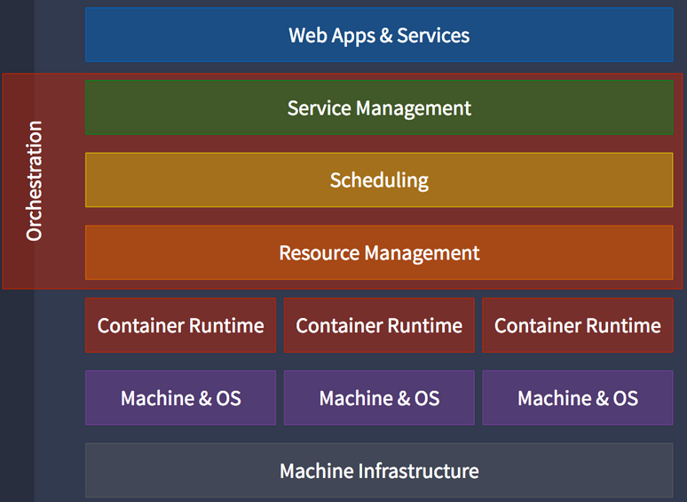
Dynamic management
Dynamic management is the orchestration of containers by managing the deployment, placement and lifecycle of containers.
Tools that provide these capabilities are called container orchestrators. They can provide:
Cluster management: Federation of multiple hosts into one target.
Schedule management: Distribution of containers across nodes via a scheduler.
Service discovery: Discover where containers are located and distributes client requests across containers.
Replication: Ensure the appropriate number of nodes and containers are available for the requested workload.
Health management: Detection and replacement of unhealthy containers and nodes.
Notes:
Kubernetes is a container orchestrator that runs and manages containers. It is a 100% open source project managed by the Linux Foundation. It has a unified API for deploying web applications, batch jobs and databases. Kubernetes maintains and tracks a global view of the cluster, while supporting multiple cloud and bare-metal environments. It is designed for extensibility with numerous plug-ins for scheduling, storage and networking. It is important to note that Kubernetes is designed to manage applications, not machines. It supports rolling updates, canary deploys, and blue-green deployments.

Slide 6
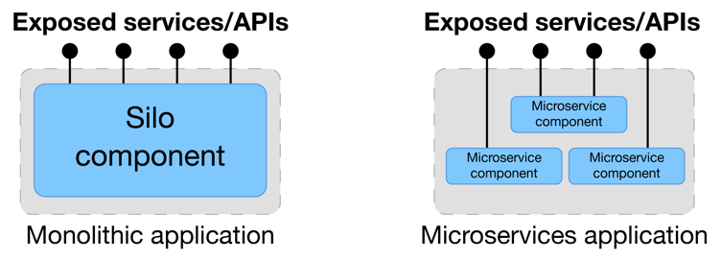
Microservices
Microservices is an engineering approach and application architectural style that reduces an application into single function modules.
Large monolithic applications are broken into small services. Services have well-defined interfaces that are independently deployed.
A single network-accessible service is the smallest deployable unit for a microservices application.
Each service runs in its own process. This rule, sometimes stated as "one service per container," can be a Docker container or any other lightweight deployment mechanism, such as a Cloud Foundry runtime.
They are operated by a small team which owns the entire lifecycle of the service.

Slide 7

Twelve-factor applications
Methodology which defines 12 factors that services should follow to build portable, resilient applications for cloud environments and accessible as web applications that deliver software-as-a-service (SaaS).
Codebase: One codebase that is tracked in revision control with many deployments
Dependencies: Explicitly declare and isolate dependencies
Configuration: Store configuration in the environment
Backing services: Treat backing services as attached resources
Build, release, run: Strictly separate build and run stages
Processes: Execute the app as one or more stateless processes
Port binding: Export services with port bindings
Concurrency: Scale out using the process model
Disposability: Maximize robustness with fast startup and efficient shutdown
Development and production parity: Keep development, staging and production as similar as possible
Logs: Treat logs as event streams
Admin processes: Run administrative and management tasks as one-off processes
Notes:
Twelve-factor apps is a set of best practices for creating applications which includes implementing, deploying, monitoring, and managing. It is a methodology which defines 12 factors that services should follow to build portable, resilient applications for cloud environments and accessible as web applications that deliver software-as-a-service (SaaS).
Twelve-factor apps have become a key yardstick by which components are measured to establish whether they are truly ready for cloud native deployment. Twelve-factor apps can be implemented in any programming language and using any backing services such as database, messaging, and caching.
A twelve-factor application has characteristics that are ideal for developing individual microservices. The 12 factors ensure an application can take advantage of the cloud infrastructure in order to deliver agility and scalability benefits. Although 12factor.net does not refer specifically to microservice architecture, it is typically used to define the appropriate characteristics for applications built as microservices. Applications built using the microservice approach typically have a need to integrate with data sources outside of the microservice architecture. For example, to integrate with systems of record built decades ago or services provided by a partner.

Slide 8
Develop Cloud-Native Applications Pattern

Slide 9
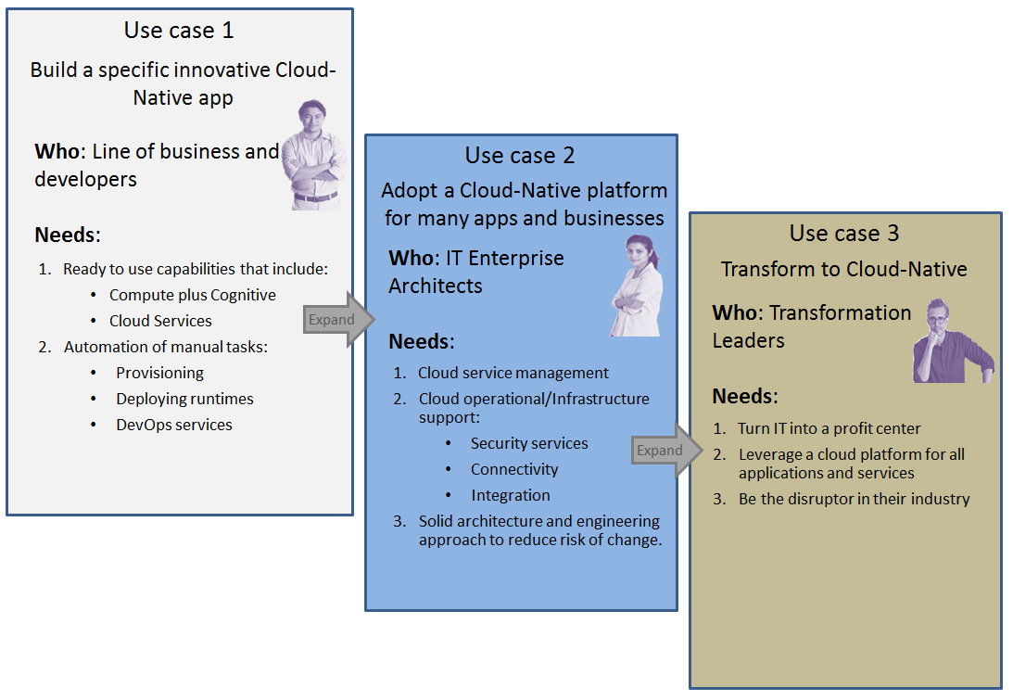
The cloud journey for developing cloud-native applications
© Copyright IBM Corporation 2017
Notes:
Cloud-native is an application architecture designed to leverage the strengths and accommodate the challenges of a standardized cloud environment, including concepts such as elastic scaling, immutable deployment, disposable instances and less predictable infrastructure. Cloud-native applications are more than just run on the cloud, they are designed and developed to maximize the economies of cloud.
Cloud-native applications have the following characteristics:
Built with the cloud in mind by using cloud services such as storage, queuing and cache.
Deployments are rapid and repeatable to maximize agility
Setup is automated to minimize time and cost for new developers
Clean contract with the underlying OS to ensure portability
Security is often specified using open standards such as OpenID or OAuth
Data might be local to the application
QoS attributes are those of the cloud:
It is always expected to be there, but sometimes sites and mobile apps become unavailable,
although they must be restored quickly.
Applications must scale elastically without significant changes to tooling, architecture, or development practice
Application must be resilient to inevitable failures in the infrastructure and application
The journey to cloud-native typically follows three use cases and audience groups. These use cases are discussed in the rest of this presentation.
Use case 1: Building a specific innovative cloud-native application
Use case 2: Adopting a cloud-native platform
Use case 3: Transforming to cloud-native

Slide 10
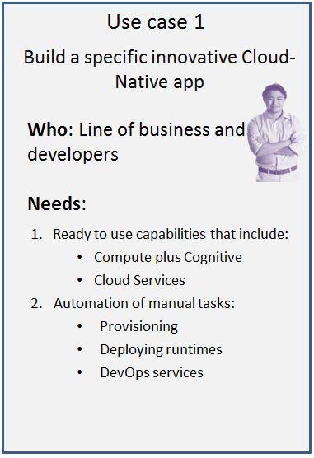
Use case 1:
Companies that want to build specific and innovative cloud native applications trend toward system of engagement applications.
These applications are typically greenfield, leaning toward ominichannel mobile and web apps.
Developers need ready-to-use innovative digital capabilities such as accessible through easy-to-use APIs :
IoT (Internet of Things)
Video
Cloud Data Services
Watson
Blockchain
…and others.
Notes:
Companies that want to build specific and innovative cloud native applications trend toward system of engagement applications. These applications are typically greenfield, leaning toward ominichannel mobile and web apps.
Omnichannel is a cross-channel business model that companies use to improve their customer experience. The approach includes channels such as physical locations, FAQ webpages, social media, live web chats, mobile applications and telephone communication. Companies use omnichannel to provide value to their customers by providing the ability to be in constant contact with a company through multiple avenues at the same time.
Developers need ready-to-use innovative digital capabilities such as IoT, video, Cloud Data Services, Watson and blockchain accessible through easy-to-use APIs.

Slide 11
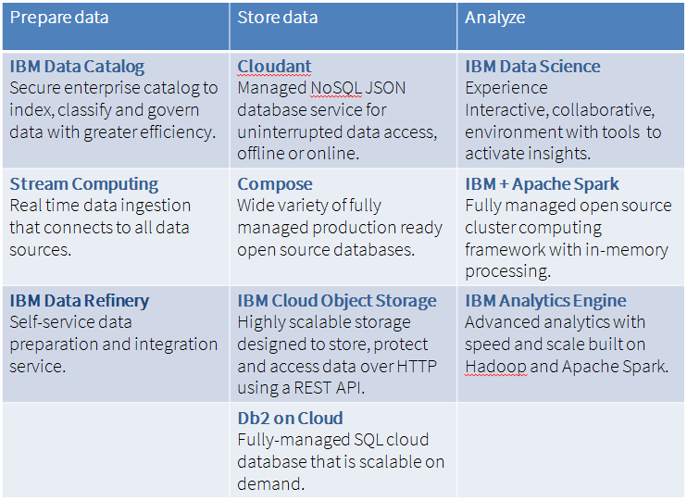
Cloud Data Services
Cloud Data Services is a term that includes a portfolio of services for all types of digital data, often needed as backend service.
They are commonly needed by an enterprise, developer or a architect when a reliable, cost effective backend is needed.
Watson Data Platform is a set of data and analytics features available on the IBM Cloud Platform

Slide 12
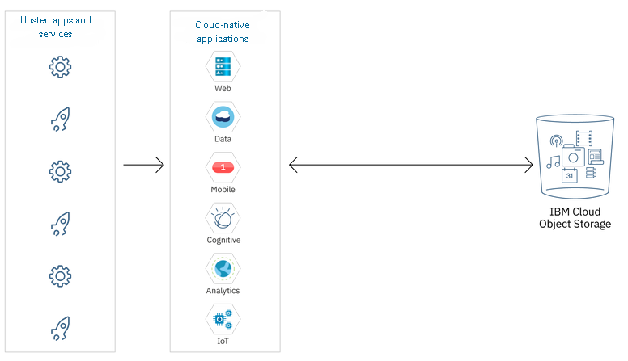
Object Storage
Object storage helps the enterprise overcome a number of issues:
Managing data at very large scales using conventional block and file systems was difficult because these technologies lead to data islands due to limitations on various levels of the data management hardware and software stack.
Managing namespace at scale resulted in maintaining large and complex hierarchies, which are required to access the data. Limitations in nested structures on traditional block and file storage arrays further contributed to data islands being formed.
Providing access security required a combination of technologies, complex security schemes, and significant human involvement in managing these areas.
Object data storage concepts include the following three constructs:
Data: This is the user and application data that requires persistent storage. It can be text, binary formats, multimedia, or any other human- or machine-generated content.
Metadata: This is the data about the data. It includes some predefined attributes such as upload time and size.
Key: A unique resource identifier is assigned to every object in an OBS system.
IBM Cloud Storage
Data slices are dispersed across multiple devices in multiple facilities for resiliency.
High data durability is maintained by built-in integrity checking and self-repair capabilities.
Developers use an IBM Cloud Object Storage API. The Cloud Object Storage API is a REST-based API
SDKs are available for Java, Node.js and Python.
Notes:
Overview
As unstructured data grows and grows, enterprises are faced with the challenge of storage. Traditional on-premises storage was never designed to handle data at such a large scale. Object storage is a modern storage technology concept and a logical progression from block and file storage. Object storage has been around since the late 1990s, but has gained market acceptance and success over the last 10 years. Object storage was invented to overcome a number of issues:
Managing data at very large scales using conventional block and file systems was difficult because these technologies lead to data islands due to limitations on various levels of the data management hardware and software stack.
Managing namespace at scale resulted in maintaining large and complex hierarchies, which are required to access the data. Limitations in nested structures on traditional block and file storage arrays further contributed to data islands being formed.
Providing access security required a combination of technologies, complex security schemes, and significant human involvement in managing these areas.
Object storage, also known as object-based storage (OBS) uses a different approach to storing and referencing data. Object data storage concepts include the following three constructs:
Data: This is the user and application data that requires persistent storage. It can be text, binary formats, multimedia, or any other human- or machine-generated content.
Metadata: This is the data about the data. It includes some predefined attributes such as upload time and size. Object storage allows users to include custom metadata containing any information in key and value pairs. This information typically contains information that is pertinent to the user or application that is storing the data and can be amended at any time. A unique aspect to metadata handling in object storage systems is that metadata is stored with the object.
Key: A unique resource identifier is assigned to every object in an OBS system. This key allows the object storage system to differentiate objects from one another and is used to find the data without needing to know the exact physical drive, array, or site where the data is.
This approach allows object storage to store data in a simple, flat hierarchy, which alleviates the need for large, performance-inhibiting metadata repositories. Data access is achieved by using a REST interface over the HTTP protocol, which allows anywhere and anytime access simply by referencing the object key.
IBM Cloud Object Storage
Information stored with IBM Cloud Object Storage is encrypted and dispersed across multiple geographic locations, and accessed over HTTP using a REST API. This service makes use of the distributed storage technologies provided by the IBM Cloud Object Storage System (formerly Cleversafe). Data is sliced, and slices are dispersed across multiple devices in multiple facilities for resiliency. High data durability is maintained by built-in integrity checking and self-repair capabilities. There are storage classes for frequently accessed data (Standard), occasionally accessed data (Vault) and long-term data retention (Cold Vault).
IBM Cloud Object Storage is available with two types of resiliency: Cross Region and Regional. Cross Region provides higher durability and availability than using a single region at the cost of slightly higher latency, and is available today in the US and EU. Regional service reverses those tradeoffs, and distributes objects across multiple availability zones within a single region, and is available in the US South and US East regions. If a given region or availability zone is unavailable, the object store continues to function without impediment.
Developers use an IBM Cloud Object Storage API to interact with their object storage. The Cloud Object Storage API is a REST-based API and supports a common set of S3 API functions for programmatic access. SDKs are available for Java, Node.js and Python with support for Identify Access and Management (IAM) and HMAC authentication. Data at rest is secured using server-side encryption and data in motion is secured using carrier-grade TLS/SSL.

Slide 13
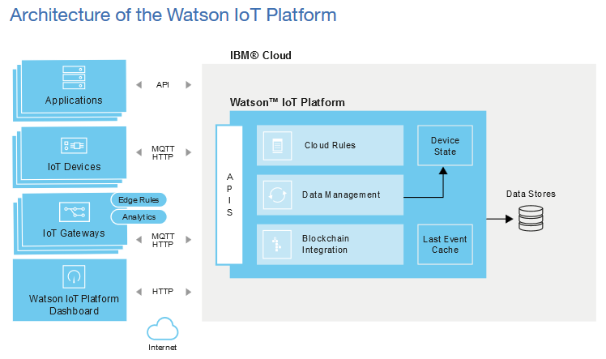
IoT – Internet of Things
Everyday objects that can be connected to the internet and be recognized by other devices and contribute info to a database.
Evolved from the convergence of wireless technologies, micro-electromechanical systems (MEMS), microservices and the Internet. The convergence has helped tear down the silo walls between operational technology (OT) and information technology (IT), allowing unstructured machine-generated data to be analyzed for insights that will drive improvements.
IBM Watson IOT Platform
Provides application access to IoT devices and data
Helps you build analytics applications, visualization dashboards, and mobile IoT apps.
Allows you to perform device management operations, and store and access device data, connect a wide variety of devices and gateway devices.
Provides secure communication to and from your devices by using MQTT and TLS.
Notes:
Overview
The Internet of Things (IoT) is everyday objects that can be connected to the internet and be recognized by other devices and contribute info to a database. The Internet of Things describes Internet V.2, where data is created by things. A thing, in the Internet of Things, can be a person with a heart monitor implant, a bald eagle with a biochip transponder, an automobile that has built-in sensors to alert the driver when tire pressure is low -- or any other natural or man-made object that can be assigned an IP address and provided with the ability to transfer data over a network.
Kevin Ashton, digital innovation expert who is credited with coining the term, defines the Internet of Things in this quote:
“If we had computers that knew everything there was to know about things—using data they gathered without any help from us—we would be able to track and count everything, and greatly reduce waste, loss and cost. We would know when things needed replacing, repairing or recalling, and whether they were fresh or past their best.”
IoT has evolved from the convergence of wireless technologies, micro-electromechanical systems (MEMS), microservices and the Internet. The convergence has helped tear down the silo walls between operational technology (OT) and information technology (IT), allowing unstructured machine-generated data to be analyzed for insights that will drive improvements. There are many products and innovations available due to the Internet of Things.
Smart home devices such as thermostats.
Wearable technology such as smart watches, fitness trackers, and viirtual reality (VR) headsets
Smart cars with app integration, navigation and diagnostic tools
IOT also impacts how business is done.
Inventory management: Smart devices that can track inventory automatically.
Consumer demands: Consumers are expecting smart behavior in all aspects of their lives. Product developers need to keep up with the demand for new gadgets, appliances and more that offer new revenue sources for businesses.
Learn from the data: The volume of data generated from smart devices can help businesses learn how and what to innovate for their biggest impact.
Remote work: With IoT becoming more integrated, more remote work opportunities will be available for tasks that used to require on-site staff to complete.
IBM Watson IOT Platform
IBM Watson IOT Platform service provides application access to IoT devices and data to help you build analytics applications, visualization dashboards, and mobile IoT apps. Watson IoT Platform allows you to perform device management operations, and store and access device data, connect a wide variety of devices and gateway devices. Watson IoT Platform provides secure communication to and from your devices by using MQTT and TLS.
The IBM Watson IoT Platform service is built on the following key areas:
Connect - Connect devices and develop applications.
Information Management - Store, normalize, transform, and review device data and integrate your Watson IoT Platform with other services.
Analytics - Visualize real-time device data by using the Watson IoT Platform dashboard.
Risk Management - Configure secure connectivity and architecture with access control for users and applications.

Slide 14
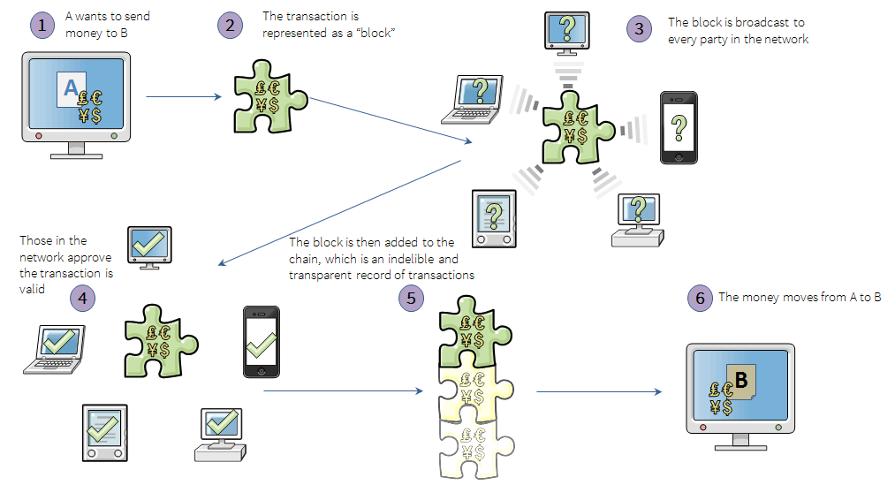
Blockchain
Public electronic ledger - similar to a relational database.
It can be openly shared among disparate users and creates an unchangeable record of their transactions, each one time-stamped and linked to the previous one.
Each digital record or transaction in the thread is called a block and it allows either an open or controlled set of users to participate in the electronic ledger.
Each block is linked to a specific participant.
Notes:
Overview
Blockchain is a public electronic ledger - similar to a relational database - that can be openly shared among disparate users and that creates an unchangeable record of their transactions, each one time-stamped and linked to the previous one. Each digital record or transaction in the thread is called a block (hence the name), and it allows either an open or controlled set of users to participate in the electronic ledger. Each block is linked to a specific participant. Blockchain can only be updated by consensus between participants in the system, and when new data is entered, it can never be erased. The blockchain contains a true and verifiable record of each and every transaction ever made in the system.
IBM Blockchain Platform
The IBM Blockchain Platform is a commercially available platform to leverage technologies from Hyperledger, a global, open source, collaborative effort hosted by The Linux Foundation. It simplifies the development, governance, and operation of a decentralized network across multiple companies or institutions forming a business ecosystem. The Hyperledger Fabric and Hyperledger Composer open source projects are achieving fundamental advancements in the standardization of permissioned blockchains for business use.
Hyperledger Fabric can be considered the "operating system" that powers the IBM Blockchain Platform.
It is a framework for distributed ledger solutions on permissioned networks, where the members are known to each other.
Network scalability and performance are optimized. Only a small subset of the nodes are required to participate in endorsing transactions. Channels help ensure that data goes only to the parties that need to know, providing data isolation for data that must be protected at all costs.
Trust is also increased as each chaincode can specify a select set of endorsers and committers that it trusts to do its execution for each particular transaction.
Chaincode is the software that encapsulates the business logic and transactional instructions for creating and modifying assets.
Chaincode runs in a Docker container associated with any peer that needs to interact with it.
Hyperledger Composer is a set of development tools.
Uses JavaScript
Business person and developer code collaboratively
Model your business network, containing assets and transactions related to them.
Developer defines assets (tangible or intangible goods, services, or property)
Developer defines transaction types and rules that govern transactions
Developer defines participants
Integrates with most JavaScript frameworks
Developer completes a project including a user interface (angular.js) and connection to external data sources (loopback)
Leverages Node-RED to integrate with IoT, TCP, and web sockets

Slide 15
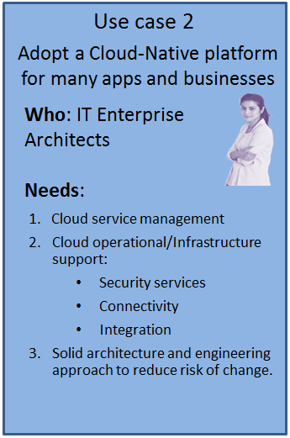
Use case 2:
Adoption typically happens when an enterprise has an application running that is supporting a client base, but the enterprise would like to add new features, modernize it and make it operationally more efficient. Enterprises that want to adopt cloud-native have done some work in microservices and leverage the standard rest interface APIs.
There are implementation scenarios for an enterprise to adopt a cloud-native platform by modernizing existing applications to cloud-native
Existing spring-based application
Traditional monolithic application such as a JEE application deployed on a WebSphere platform

Slide 16
Implementation scenarios
Develop polyglot cloud-native application
Develop Spring Cloud application
Develop and deploy a Microprofile application
Develop cloud-native application by using Istio
Deploy to Kubernetes platform
Deploy using Cloud Foundry
Deploy application to both public and private
Multi-cluster topologies
DevOps with CI/CD pipeline
Operations, CSMO
Notes:
CF uses containers to separate Build from Run. This is accomplished in two stages, shown in this slide and the next one.
A CF buildpack builds a Droplet, which is essentially the container image that contains the app, its configuration, and its runtime--but without the OS (which the runtime will require to run).

Slide 17
Develop polyglot cloud-native application
Customers need to develop the application with different programming languages or frameworks
Node.js, Java, Swift
For Java developer, choices of JAX-RS, Spring, Microprofile
Example:
Reference implementation
https://github.com/ibm-cloud-architecture/refarch-cloudnative-kubernetes
GameOn Java Microservices
https://github.com/IBM/GameOn-Java-Microservices-on-Kubernetes
Notes:
The CF DEA then combines the Droplet image with an OS image to produce a Warden container, which is a fully executable runtime. The container is immutable, so it’s stateless (or won’t maintain state).
This is the patterns Containerization and Container per Service.
Once the image is built and released, it cannot be changed. (New pushes of the same app build new images that replace the old one(s).) Thus new instances (containers) can be created (such as for elasticity) that are exactly like the old ones that have already been deployed. This is much better than recompiling the code and reinstalling the runtime each time, which might not result in a new instance that is exactly like the old instance. Thus Build and Release is only done once, then Run is done whenever needed.

Slide 18
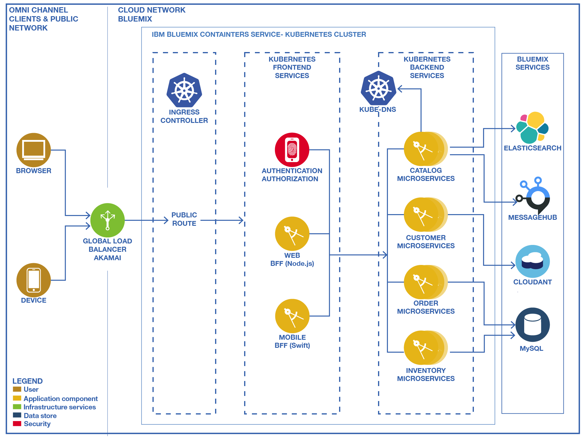
Reference application
© Copyright IBM Corporation 2017

Slide 19
Develop a Spring Cloud application
Spring Cloud is one of the popular choices to build Microservices applications
Spring Cloud provides tools for developers to build some of the common patterns in distributed systems:
Configuration management
Service discovery
Circuit breakers
Intelligent routing
Micro-proxy
Control bus
Distributed sessions
Cluster state
Using Spring Cloud, developers can stand up services and applications that implement these patterns. They work well in any distributed environment, including the developer's own laptop, bare metal data centers, and managed platforms such as Cloud Foundry.
© Copyright IBM Corporation 2017

Slide 20
Develop and deploy a MicroProfile application
MicroProfile is a programming model for microservices
The MicroProfile 1.0 specification includes three APIs of the 30+ Java Enterprise specifications. This represents the least number of APIs required to build a microservice.
JAX-RS 2.0 for RESTful endpoints
CDI 1.1 for extensions and dependency injection
JSON-P 1.0 for processing JSON messages.
MicroProfile 1.2 includes:
Configuration 1.1
Fault Tolerance
JWT
Metrics
Health Check
Microservice Builder is IBM tooling for developing MicroProfile applications
© Copyright IBM Corporation 2017

Slide 21
Manage Microservices application by using Istio
Istio is an open platform that provides a uniform way to connect, manage, and secure microservices
Customers want optimized Microservices design and deployment pattern
Service Mesh: service discovery, routing, failure handling, and visibility to microservices
Istio: Intelligent routing, language- and platform-neutral, policy enforcement, telemetry and reporting
Sample Istio implementation:
https://github.com/IBM/microservices-traffic-management-using-istio
© Copyright IBM Corporation 2017
Notes:
Istio is an open platform service mesh implementation for connecting, managing, and securing microservices. Istio provides an easy way to create a network of deployed services with load balancing, service-to-service authentication, monitoring, and more, without requiring any changes in service code. You add Istio support to services by deploying a special sidecar proxy throughout your environment that intercepts all network communication between microservices, configured and managed using Istio’s control plane functionality.
Istio provides the following capabilities.
Intelligent routing and loading balancing: Control traffic between services with dynamic route configuration, conduct A/B tests, release canaries, and gradually upgrade versions using red/black deployments.
Resilience across languages and platform: Increase reliability by shielding applications from flaky networks and cascading failures in adverse conditions.
Fleet wide policy enforcement: Apply organizational policy to the interaction between services, ensure access policies are enforced and resources are fairly distributed among consumers.
In-depth telemetry and reporting: Understand the dependencies between services, the nature and flow of traffic between them and quickly identify issues with distributed tracing.

Slide 22
Deploy on Kubernetes platform
Customers need to run Microservices with container technology
An app packaged using Docker
Containers are orchestrated and intelligently managed by Kubernetes
Kuberenetes as a service on IBM Cloud Private and IBM Public Cloud
Deploy to Kuberentes
Deploy using a Helm chart or Kubernetes components
To both private cloud IBM Cloud Private and public cloud
https://github.com/ibm-cloud-architecture/refarch-cloudnative-kubernetes
© Copyright IBM Corporation 2017

Slide 23
Deploy by using Cloud Foundry
Customers need to deploy applications to a Cloud Foundry runtime
An app should push to and run in Cloud Foundry in IBM Cloud Private the same as in Public
Deploy an app to Bluemix Instant Runtimes (a.k.a. Cloud Foundry)
Cloud Foundry selects appropriate buildpack and creates runtime
Validate application functionality
Deploy the same app to IBM Cloud Private
IBM Cloud Private selects the same buildpack
Validate application functionality
© Copyright IBM Corporation 2017
Notes:
Cloud Foundry is an open platform for running applications, tasks, and services. Its purpose is to change the way applications, tasks, and services are deployed and run by significantly reducing the develop-to-deployment cycle time.
Since Cloud Foundry is an open platform, it allows for:
A choice of an IaaS layer, such as IBM Cloud Private, Google Cloud Platform, Amazon Web Services, Azure, VMware vSphere, OpenStack, and so on.
Many different developer frameworks, polyglot languages, and application services (Ruby, Go, Spring, and so on)
An open-sourced Apache 2 license and governed by a multi-organization foundation.
As a cloud-native platform, Cloud Foundry directly uses cloud-based infrastructure so that applications running on the platform can be infrastructure unaware. Cloud Foundry provides a contract between itself and your cloud-native apps to run them predictably and reliably, even in the face of unreliable infrastructure.
The Cloud Foundry platform offers:
Services as a higher level of abstraction above infrastructure: Cloud Foundry provides a self-service mechanism for the on-demand deployment of applications bound to an array of provisioned middleware and routing services. This benefit removes the management overhead of both the middleware and infrastructure layer from the developer, significantly reducing the development-to-deployment time.
Containers: Cloud Foundry runs all deployed applications in containers. You can deploy applications as container images or as standalone apps containerized by Cloud Foundry. If you have established with Docker, you can deploy existing Docker images to Cloud Foundry.
Agile and automation: You can use Cloud Foundry as part of a CI/CD pipeline to provision environments and services on demand as the application moves through the pipeline to a production-ready state. This helps satisfy the key Agile requirement of getting code into the hands of end users when required.
Microservices support: Cloud Foundry supports microservices by providing mechanisms for integrating and coordinating loosely coupled services. To realize the benefits of microservices, a platform is required to provide additional supporting capabilities; for example, Cloud Foundry provides applications with capabilities such as built-in resilience, application authentication, and aggregated logging.
Cloud-native application support: Cloud Foundry provides a contract against which applications can be developed. This contract makes doing the right thing simple and will result in better application performance, management, and resilience.

Slide 24
Deploy an application to both public and private
Customers need application portability between Public and IBM Cloud Private
An app packaged (using Docker and Kubernetes, as well as Cloud Foundry) to deploy in Public should also deploy in IBM Cloud Private
Use one environment as development/test, the other as performance/production
Customers need to deploy an application where part runs in public and part runs in private
The system of engagement (SoE) runs in Public
The system of record (SoR) runs in IBM Cloud Private
Deploy by using a Helm chart
Deploy the same app to IBM Cloud Private
Deploy by using the same Helm chart
© Copyright IBM Corporation 2017

Slide 25
Multi-cluster topologies (1 of 2)
Deploy an application in multiple clusters:
Avoid the cluster being a single point of failure or bottleneck
Active-active, global replication, active-standby with disaster recovery, backup/restore
Demonstrate robustness across clusters:
Data replication and backup/restore for persistence (data) layer
Geo-based global load balancing
Resiliency of Istio components, synchronization of service mesh
Disaster recovery across active and passive/standby instances
https://github.com/ibm-cloud-architecture/refarch-cloudnative-resiliency/tree/kube-int
© Copyright IBM Corporation 2017

Slide 26
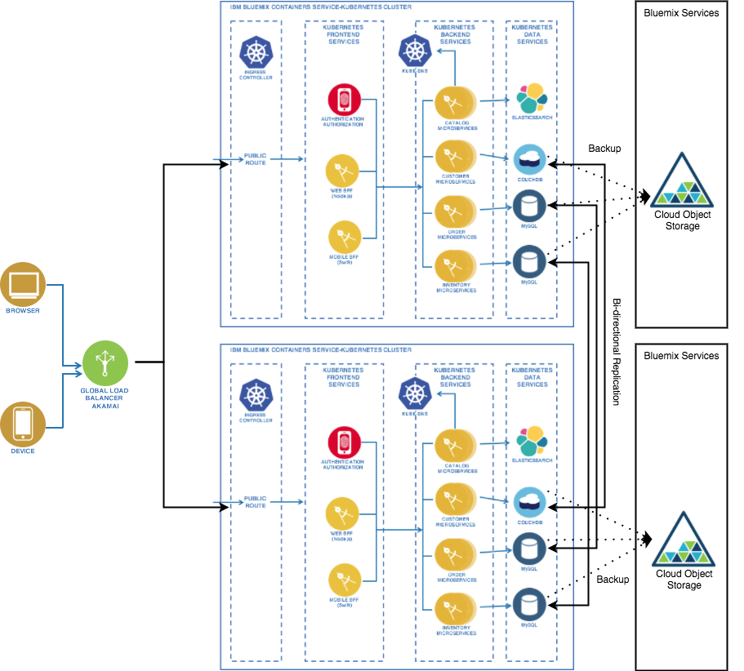
Multi-cluster topologies (2 of 2)
© Copyright IBM Corporation 2017

Slide 27
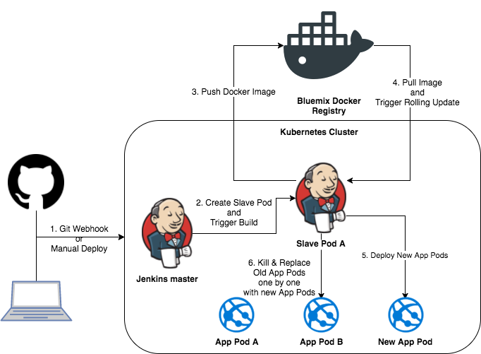
CI/CD DevOps for cloud-native
Use a CI/CD pipeline to deploy applications
CI/CD is the most basic aspect of DevOps
One pipeline per Microservice
© Copyright IBM Corporation 2017

Slide 28
Operations/CSMO
Manage the operations of your applications:
Cloud Service Management and Operation (CSMO), the Ops in DevOps
Assure availability and performance of applications
Control risks and minimize time to restore service
CSMO demonstrated:
Monitor/alert/ticket IBM Cloud Private infrastructure, services, applications, and log entries
Search across log files on IBM Cloud Private
Retain log files for greater than 90 days
Visualize an application’s health and resource consumption in a dashboard
Get metric data for capacity planning
© Copyright IBM Corporation 2017

Slide 29
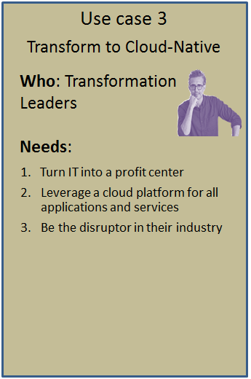
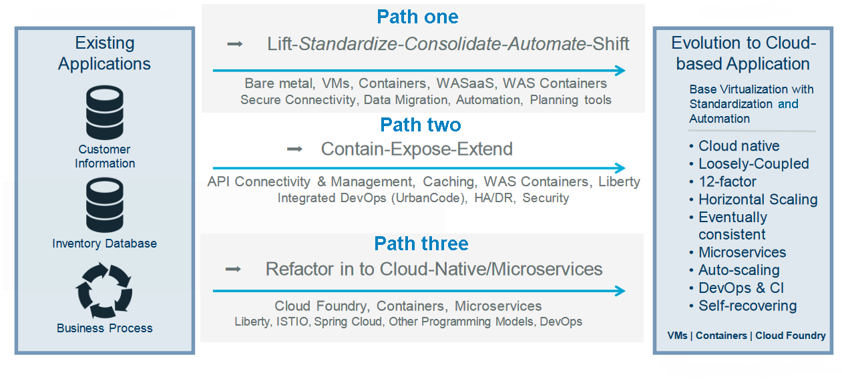
Use case 3:
Transforming or evolving existing applications to cloud-native can be broken down into three paths.
Path one: Migrate existing applications to a virtualized infrastructure with a lift-and-shift approach while maintaining continuous application delivery.
Path two: Shift monolithic applications toward microservices architecture, running services in containers on a platform as a service (PaaS).
Path three: Implement rapidly scalable microservices and deploy them across the cloud platform's software-defined architecture

Slide 30
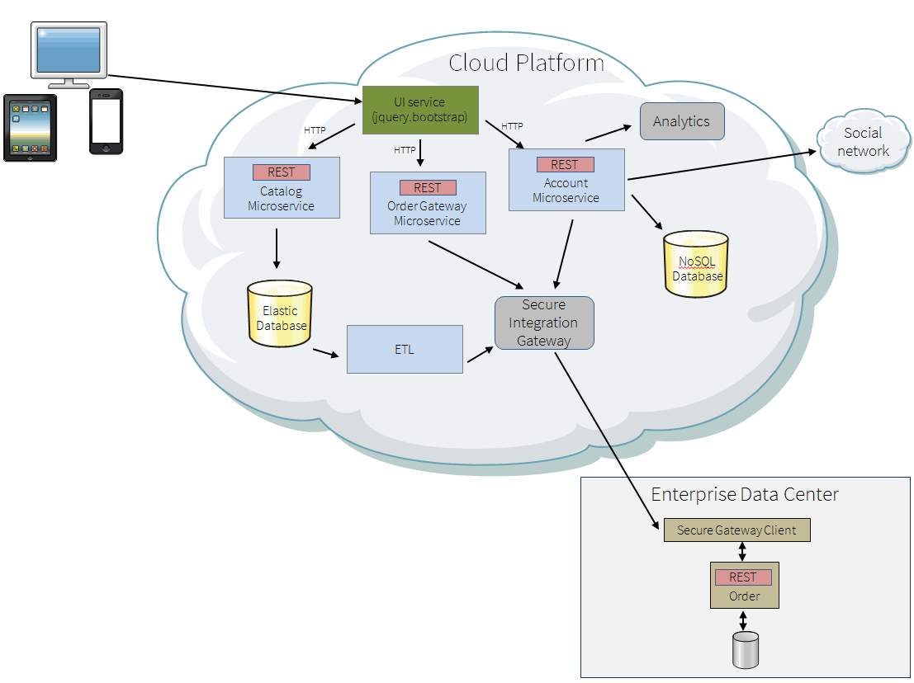
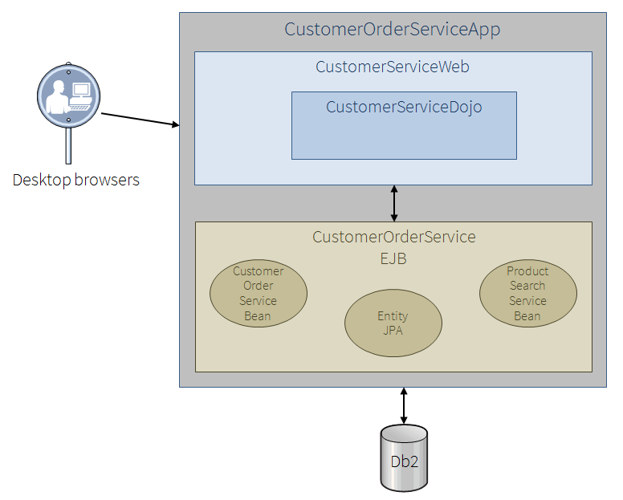
Refactor to cloud-native microservices
The current architecture has a single relational database schema that contains in product, customer, ordering and other information.
There is a single EAR file that uses an EJB and JPA for persistence.
The customer experience is provided through a Dojo Web Application.
The refactored architecture is implemented with rapidly scalable microservices
Catalog data is imported into Elastic Search with fuzzy search capabilities.
Customer data is modeled and stored in a document NoSQL store
Notes:
The current architecture has a single relational database schema that contains in product, customer, ordering and other information. There is a single EAR file that uses an EJB and JPA for persistence. The customer experience is provided through a Dojo Web Application. There are several business problems presented with this architecture. There are limited searching capabilities for products and other information. Little knowledge of the customer is surfaced through this architecture. The ordering system is complex. It is difficult to add product and customer analytics to the site without breaking the ordering system.
The refactored architecture is implemented with rapidly scalable microservices and deployed across the cloud platform's software-defined architecture.
Catalog data is imported into Elastic Search with fuzzy search capabilities.
Customer data is modeled and stored in a document NoSQL store with analytic and social data.
The Order Gateway microservice wraps on-premise (existing) ordering with a secure integration gateway.
The new mobile application uses several microservices.
The existing website has evolved by implementing the Strangler Application pattern.

